Slide 1
M&A CROSS-SELLING
SUCCESS FACTORS

Slide 2

Agenda
Synergy Approach
Early Wins Prioritization
Key Cross Selling Factors
© 100-Day Advisors MandAPlaybook.com
01

Slide 3

Synergy Approach
TOP-DOWN SYNERGY ANALYSIS
Corporate development determines ﬁrst draft of synergies
BOTTOMS UP VALIDATION
Owners of each synergy review and validate each synergy including
cost to achieve and timing
© 100-Day Advisors MandAPlaybook.com
02

Slide 4

Early Wins Prioritization
Large Synergy
Small Effort
Large Synergy
Large Effort
Small Synergy
Small Effort
Small Synergy
Large Effort
Initially focus on synergies that can be accomplished without great effort within 30 days. Ignore small synergies that require a large effort.
© 100-Day Advisors MandAPlaybook.com
03

Slide 5

Key Cross Selling Success Factors
Question
Comments
How well do the two companies’ products, services, and accounts complement each other for cross-selling?
Cross-selling opportunity scales with portfolio fit — the ability to bring existing products to new customers and new products to existing ones. The stronger the complementarity, the larger the revenue upside.
Do we have trusted customer relationships to build on?
Relationship quality is the strongest predictor of cross-selling success. Shallow or transactional relationships limit the pace of expansion and require significant account development investment before cross-selling becomes viable.
© 100-Day Advisors MandAPlaybook.com
04

Slide 6

Key Cross Selling Success Factors
Question
Comments
Can the sales team shift focus to cross-selling without compromising core pipeline and quota?
Sales capacity is finite. Without purpose-built tools, streamlined processes, and protected time, cross-selling will compete directly with quota attainment — and sellers will always default to the familiar path.
Does the sales team have the consultative skills and product breadth to cross-sell the combined portfolio?
Cross-selling requires a fundamentally different sales motion. Companies consistently underestimate the behavioral shift required: from transactional to consultative, from single-product to solution-based, and from account maintenance to active growth. Each transition demands structured enablement — not just expectation setting. Companies that skip this step routinely fall short of their cross-selling targets.
© 100-Day Advisors MandAPlaybook.com
05

Slide 7

Key Cross Selling Success Factors
Question
Comments
Are the right incentives in place to motivate and sustain cross-selling behavior across the salesforce?
The majority of M&A executives rate incentive alignment as important or critical to cross-selling success. Compensation drives behavior — but it is not sufficient alone. A well-structured plan must be paired with recognition programs that reinforce the right selling behaviors, not just reward headline outcomes.
Is the organization genuinely committed to cross-selling as a strategic priority?
Commitment has the highest correlation with cross-selling program success. Treat it as a distinct change initiative — with executive sponsorship, clear accountability, and the same rigor applied to any top strategic priority.
© 100-Day Advisors MandAPlaybook.com
06

Slide 8
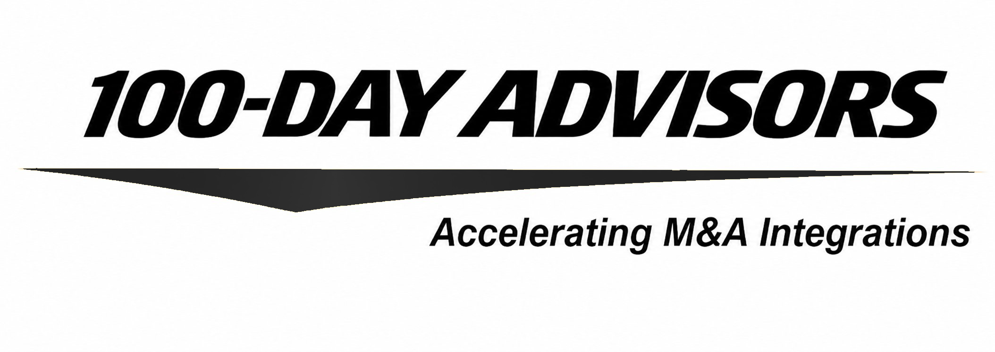


thank you
contact us
email
inquiries@MandAPlaybook.com
website
MandAPlaybook.com/consulting
07

